Slide 1
A Presentation on Car Rental
Presented By:
Raju Bhattarai(343595)
Kamal Baraili(343591)
Bhanubhakta Belbase(343587)

Slide 2
Content
Introduction
Objectives
Features
Existing system overview
Programming platform
Gantt Chart
Context Diagram
DFD Level 1
ER Diagram
Use case Diagram
Conclusion
Limitation
Future Enhancement

Slide 3
Introduction
Car rental system is a web based system for a company that rents out cars.
This system enables a company to make their services available to the public through the internet.
This system rents car for a short period of time or for few days or week.

Slide 4
Objectives
To reach customer and provide car renting services.

Slide 5
Features
Login and Registration.
Browse car information.
Car details.
Car booking.

Slide 6
Existing system overview
System 1: Kathmandu Car Services
Kathmandu car services provides a car rental services which is easy to book , whatever your budget, with multiple car choices.
Pros
Flexibility in travelling.
Varieties of vehicles.
Cons
Driver is needed to be hired along with car.
Confusing interface.

Slide 7
System 2: Self Drive Nepal
Self Drive Nepal are Nepal's largest self drive vehicle rental company. With just a touch, books your next drive for all over Nepal.
Pros
Easy to use and book cars.
Affordable price.
Cons
Complex interface.

Slide 8
Programming platform
Front-end Web Development
HTML 5
JavaScript ES6
CSS
Software Requirement (Tested on)
Operating System: Windows 10
Browser: Mozilla Firefox 103.0.2(64-bit)
Hardware Requirement
Processor: i3
System Bus: 64 bit
RAM: 4GB
HDD: 1 TB

Slide 9
Gantt Chart
S.N. | Tasks | April | May | June | July | August
1. | Concept Submission
2. | Requirement Gathering
3. | System Analysis & Designing
4. | Coding
5. | Testing and debugging
6. | Documentation
Index:
Task completed
Total Time: 5 months

Slide 10
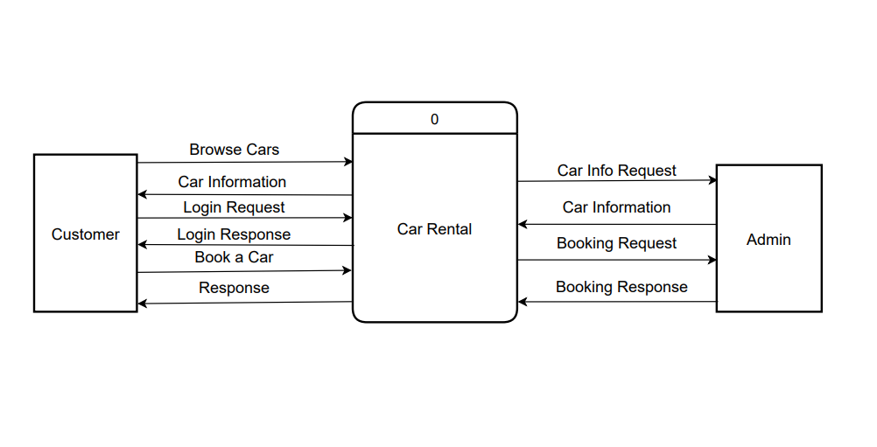
Context Diagram
Figure 1 : Context diagram

Slide 11
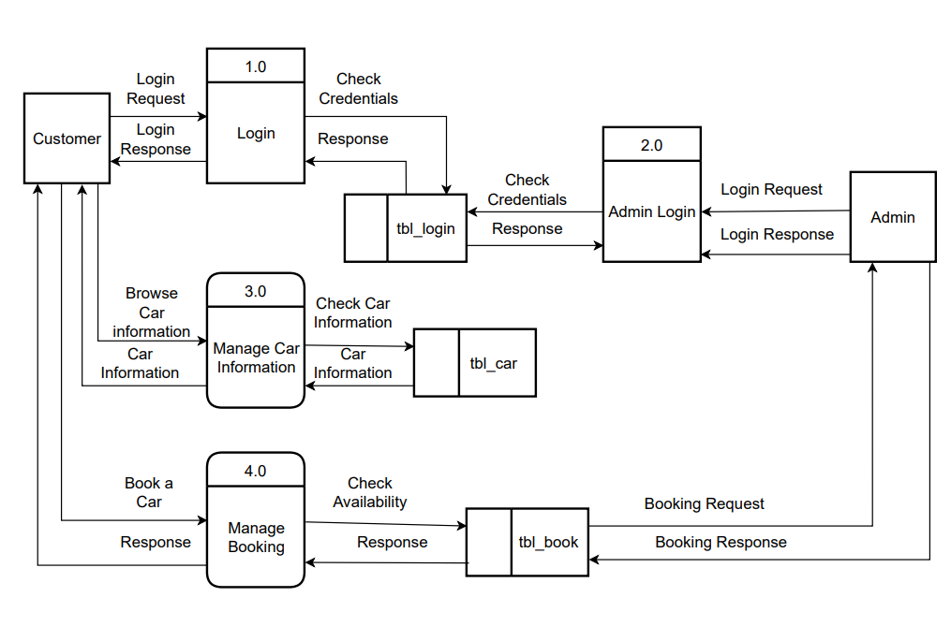
DFD Level 1 Diagram
Figure 2 : DFD Level 1

Slide 12
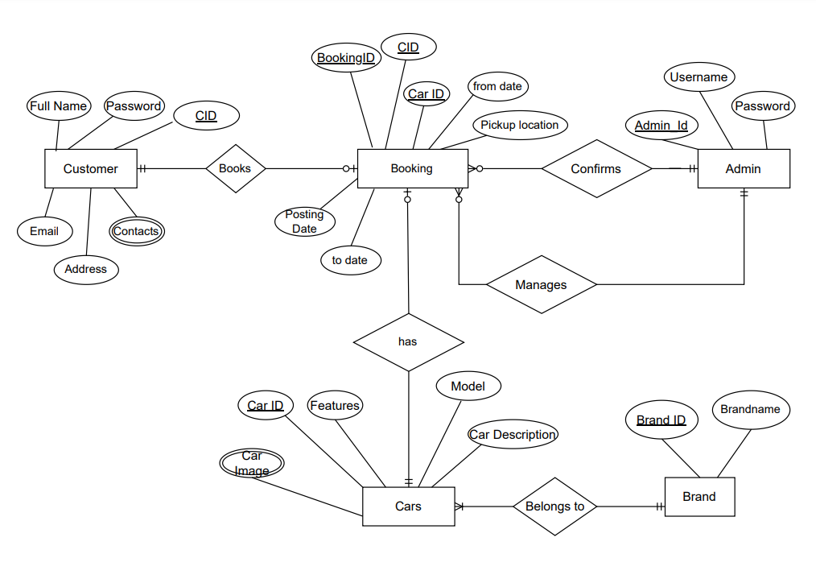
ER Diagram
Figure 3 : ER diagram

Slide 13
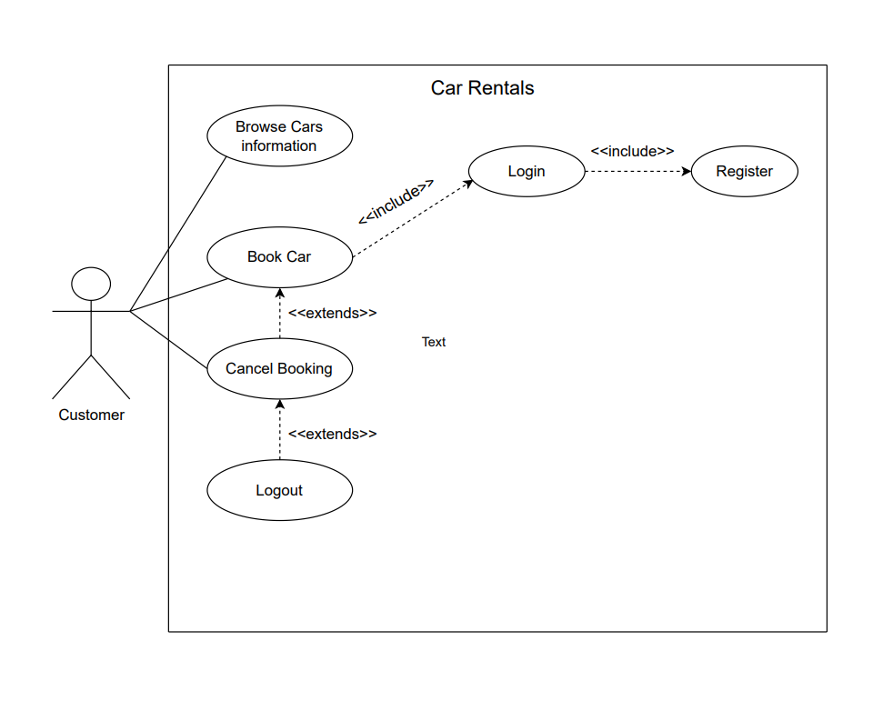
Use Case Diagram
Figure 4 : Use Case diagram

Slide 14
Conclusion
Car rental system was successfully created and the web application is user friendly and is efficient and saves times to rent a car easily and conveniently.

Slide 15
Limitation
No database and site is still static.

Slide 16
Future Enhancement
It can be made more user customizable.

Slide 17
THANK YOU !

